Slide 1
Adaptive Web Server Optimisation:
A FuzzyART-Based Classifier for Dynamic Request Patterns
Charlotte Lee
29 May, 2025

Slide 2
AGENDA
Introduction
Methodology
Background on Adaptive Web Server
System Architecture Overview
FuzzyART
UCB1 Agent
3. Results
Experiment Set Up
Single-learning Agent
FuzzyART Result
Multi-learning Agent
4. Conclusion

Slide 3
INTRODUCTION
Modern software systems operate in unpredictable and dynamic environments.
Self-adaptive systems - manage and adjust themselves without human intervention.
Challenge in Adaptive Web Servers:
Handling constantly changing web request patterns.
Managing sudden traffic spikes, resource-heavy processes, and low traffic periods.
Limitations of Reinforcement Learning:
RL struggles with slow convergence in real-world, dynamic traffic patterns.
My Approach:
Introduce a FuzzyART-based classifier.
Real-time categorization of web request patterns.
Enhance RL systems to adapt faster and perform more effectively.

Slide 4
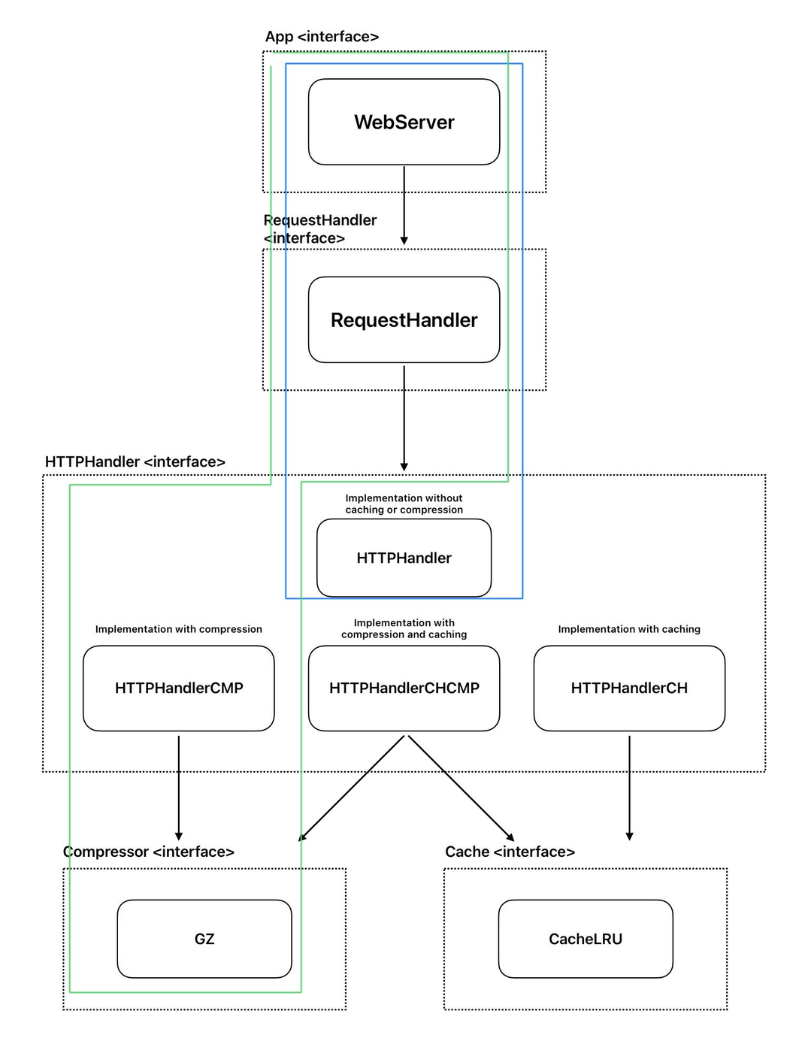
BACKGROUND ON
ADAPTIVE WEB SERVER
Type 0
Return requested files to clients
Managed using different component configurations
Variable request patterns—different frequency and type of files
Cost metric: Response Time
Type 2
Type 0: Default setup (Blue box)
Type 1: Caching enabled
Type 2: Compression enabled (Green box)
Type 3: Both caching and compression enabled
Different server composition

Slide 5
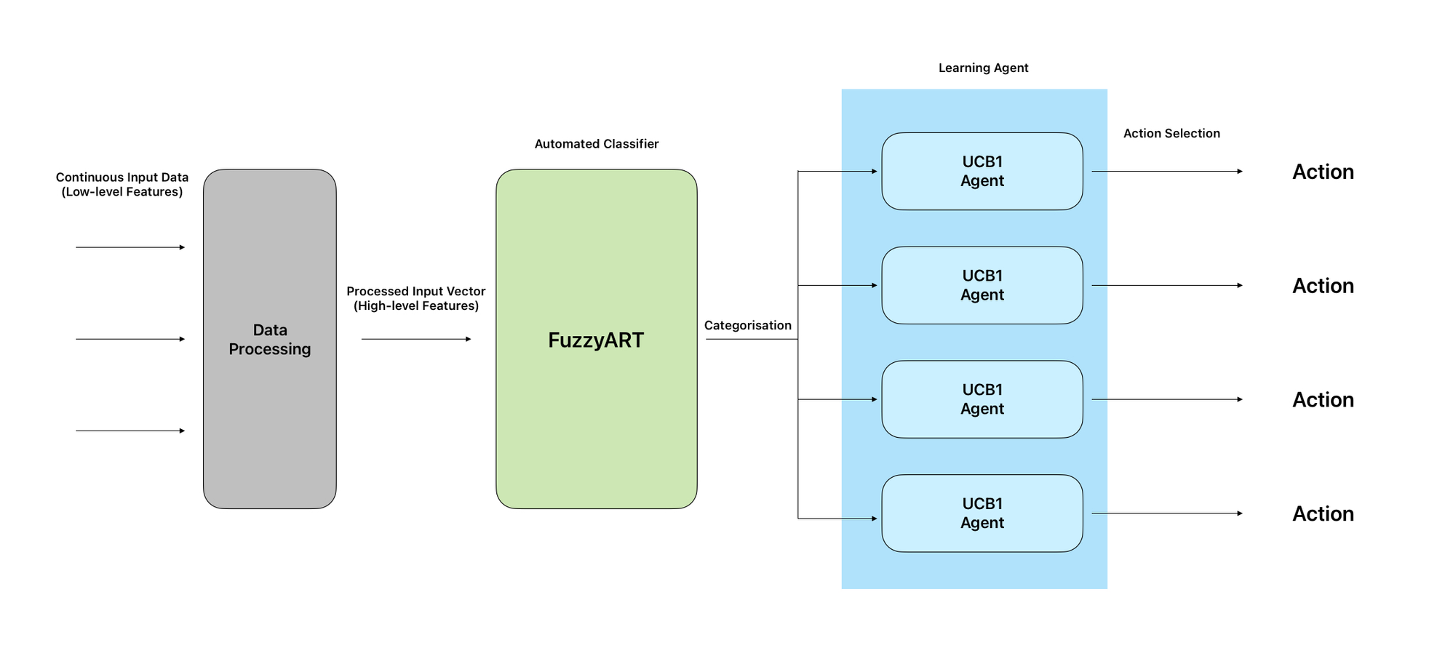
SYSTEM ARCHITECTURE OVERVIEW

Slide 6
DATA PROCESSING
The high-level features: average text size, average image size and entropy
Entropy: randomness of file requests over time

Slide 7
FUZZYART
Groups similar request patterns into categories.
Compares incoming data with existing categories by calculating a similarity measure (D) between input and neurons.
Vigilance parameter ρ:
If D ≥ ρ, the input joins that category.
If not, a new category is created automatically.
Learning rate β:
Controls how much the new input updates or influences the existing category.

Slide 8
UCB1 AGENTS
UCB1 is a Reinforcement Learning (RL) algorithm.
Balances exploration and exploitation to select the optimal server composition.
Exploitation:
Selects the action with the highest current estimated reward.
Focuses on short-term performance.
Exploration:
Occasionally tries less-explored actions.
Aims to find better long-term options.

Slide 9
EXPERIMENT SETUP
x15
big_img
med_img
small_txt
var_big_img
var_med_img
20s
20s
20s
20s
20s
Setup Overview:
Five different request patterns were prepared.
Some consist a set of files.
Some consist only a single file.
Process:
Each pattern ran continuously for 20 seconds.
The full sequence of five patterns was looped 15 times.
Perception data collected approximately every 2 seconds.

Slide 10
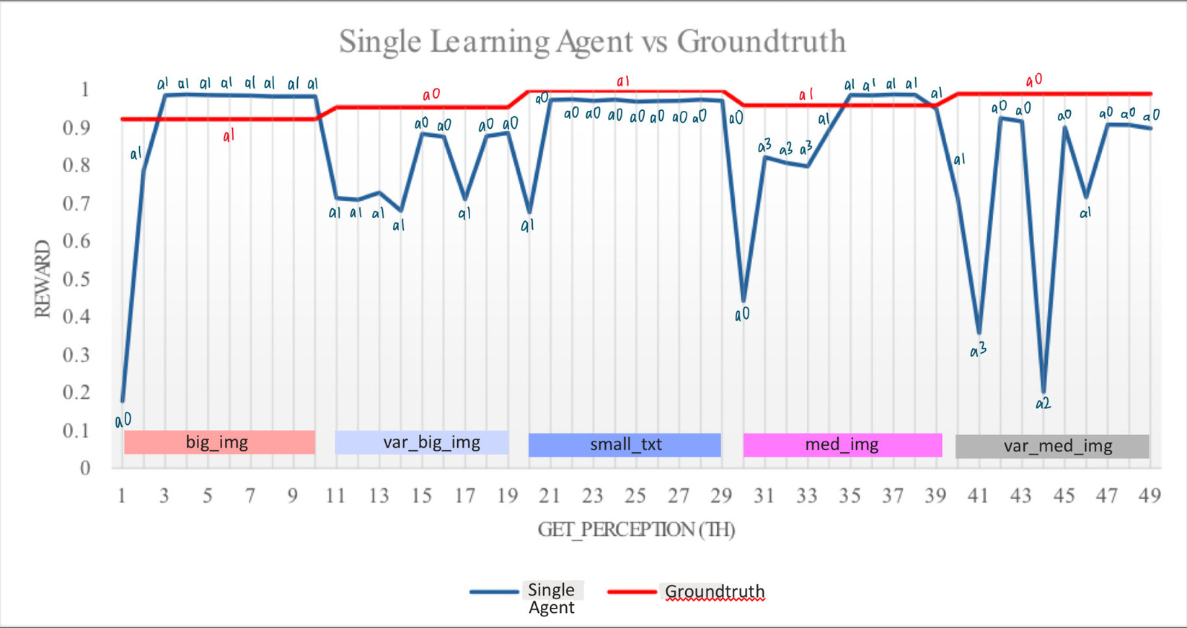
SINGLE AGENT LEARNING PERFORMANCE
A single UCB1 agent learning the best action across all request patterns.
Blue line: Agent's selected actions over time.
Red line: Ground truth (ideal action).
The agent struggles to adapt immediately when the request pattern switches.

Slide 11
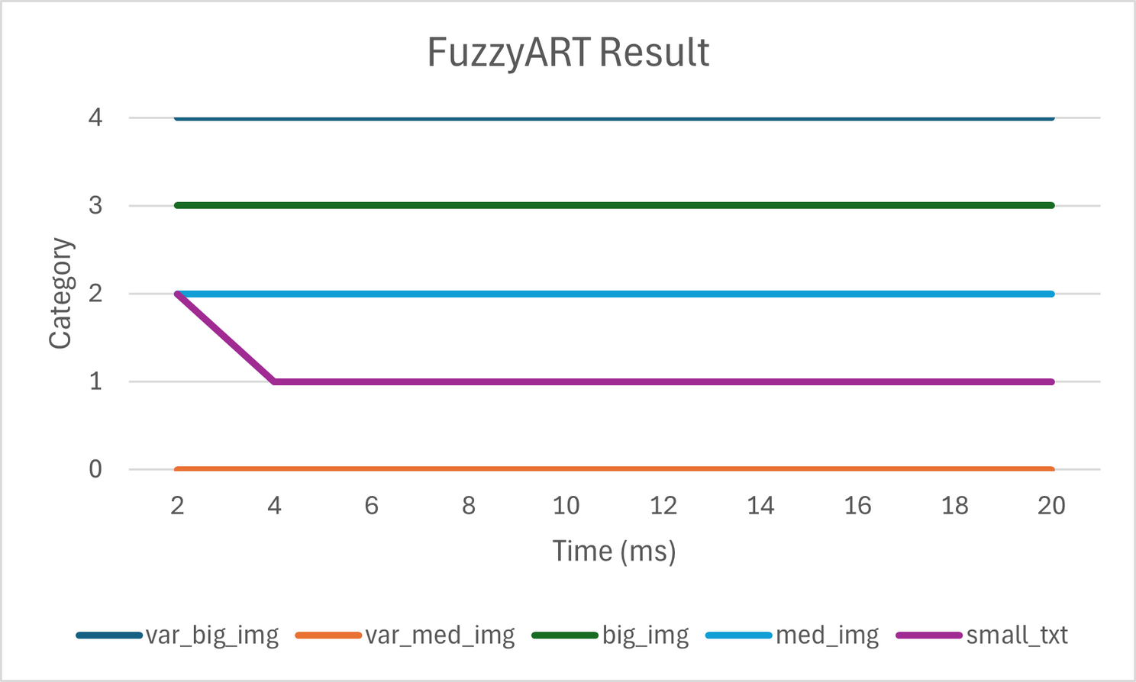
FUZZYART RESULT
FuzzyART classifier assigned incoming requests to categories during the last loop for each pattern.
Accuracy: 98%
F1-Score: 0.98

Slide 12
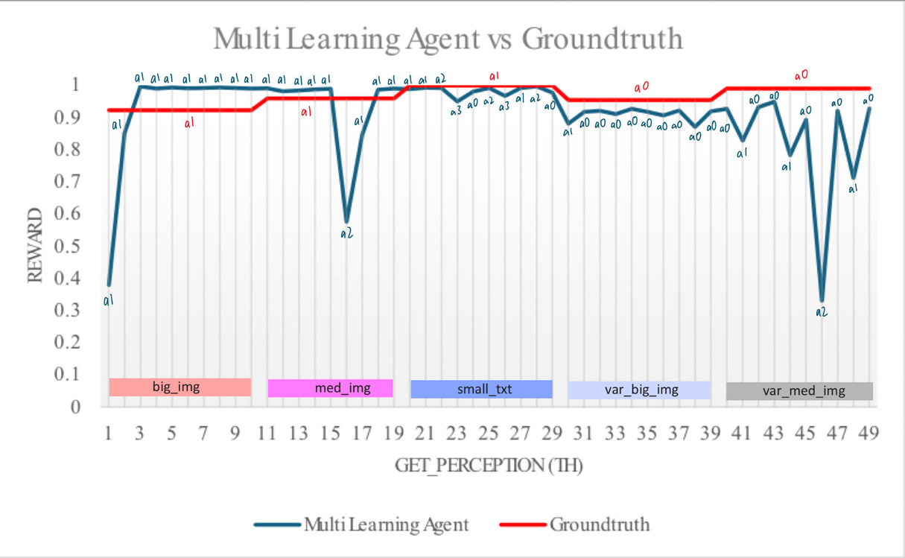
MULTI AGENT LEARNING PERFORMANCE
In the multi-agent setup, each detected request pattern had its own dedicated UCB1 agent.
More consistent action selection and rewards.
Each agent specialized in its request pattern, avoiding the need for relearning.
The performance increases 38.69% in terms of response time.
The FuzzyART-based classifier significantly improves learning consistency and overall system performance.

Slide 13

CONCLUSION
Proposed a FuzzyART model to classify dynamic web request patterns in real-time.
Enables the learning agent to better identify the optimal web server composition with adapting to changing request patterns.
Integrating a FuzzyART-based classifier with RL significantly enhances system performance in dynamic and unpredictable environments.

Slide 14
REFERENCES
[1] M. Chow, D. Meisner, J. Flinn, D. Peek, and T. F. Wenisch, “The mystery machine: End-to-end performance analysis of large-scale internet services,” in 11th USENIX Symposium on Operating Systems Design and Implementation (OSDI 14), 2014, pp. 217–231.
[2] M. Salehie and L. Tahvildari, “Self-adaptive software: Landscape and researchchallenges,” ACM Trans. Auton. Adapt. Syst., vol. 4, no. 2, May 2009. [Online].Available: https://doi.org/10.1145/1516533.1516538
[3] D. Ardelean, A. Diwan, and C. Erdman, “Performance analysis of cloud applications,” in 15th USENIX Symposium on Networked Systems Design and Implementation (NSDI 18), 2018, pp. 405–417.
[4] B. Porter, M. Grieves, R. R. Filho, and D. Leslie, “Rex: a development platform and online learning approach for runtime emergent software systems,” in Proceedings of the 12th USENIX Conference on Operating Systems Design and Implementation,
ser. OSDI’16. USA: USENIX Association, 2016, p. 333–348.
[5] R. Zhang, Y. Xu, Z. Y. Dong, and K. P. Wong, “Post-disturbance transient stability assessment of power systems by a self-adaptive intelligent system,” IET Generation, Transmission & Distribution, vol. 9, no. 3, pp. 296–305, 2015. [Online]. Available: https://ietresearch.onlinelibrary.wiley.com/doi/abs/10.1049/iet-gtd.2014.0264
[6] A. Rullo, D. Midi, A. Mudjerikar, and E. Bertino, “Kalis2.0 -a secaas-based context aware self-adaptive intrusion detection system for the iot,” IEEE Internet of Things Journal, vol. 11, no. 7, pp. 1–1, 2024.
[7] W. Liang, W. Huang, J. Long, K. Zhang, K.-C. Li, and D. Zhang, “Deep reinforcement learning for resource protection and real-time detection in iot environment,” IEEE Internet of Things Journal, vol. 7, no. 7, pp. 6392–6401, 2020.

Slide 15
REFERENCES
[8] C. Cui, C. Li, and M. Li, “An online reinforcement learning method for multi-zone ventilation control with pre-training,” IEEE Transactions on Industrial Electronics, vol. 70, no. 7, pp. 7163–7172, 2023.
[9] X. Wang, J. Tang, M. Yu, G. Yin, and J. Li, “A ucb1-based online job dispatcher for heterogeneous mobile edge computing system,” in 2018 Third International Conference on Security of Smart Cities, Industrial Control System and Communications (SSIC), 2018, pp. 1–6.
[10] J. Lee, I. Joo, T. Kang, and et al., “Deep learning with ultrasonography: automated classification of liver fibrosis using a deep convolutional neural network,” Eur Radiol, vol. 30, no. 3, pp. 1264–1273, 2020. [Online]. Available: https://doi-org.ezproxy.lancs.ac.uk/10.1007/s00330-019-06407-1
[11] S. Nuvoli, A. Spanu, M. Fravolini, and et al., “[123i]metaiodobenzylguanidine (mibg) cardiac scintigraphy and automated classification techniques in parkinsonian disorders,” Mol Imaging Biol, vol. 22, no. 5, pp. 703–710, 2020. [Online]. Available: https://doi-org.ezproxy.lancs.ac.uk/10.1007/s11307-019-01406-6
[12] S. Tr¨ager, G. Tam`o, D. Aydin, G. Fonti, M. Audagnotto, and M. Dal Peraro, “Clone:automated clustering based on local density neighborhoods for application to biomolecular structural ensembles,” Bioinformatics, vol. 37, no. 7, pp. 921–928, may2021.
[13] G. Viraraghavan, P. J. Cahill, M. G. Vitale et al., “Automated clustering technique (act) for early onset scoliosis: A preliminary report,” Spine Deformity, vol. 11, pp. 723–731, 2023. [Online]. Available: https://doiorg.ezproxy.lancs.ac.uk/10.1007/s43390-022-00634-1
[14] K. Klarich, B. Goldman, T. Kramer, P. Riley, and W. P. Walters, “Thompson sampling—an efficient method for searching ultralarge synthesis on demand databases,” Journal of Chemical Information and Modeling, vol. 64, no. 4, pp. 1158–1171, 2024.

Slide 16
Thank you

